Slide 1
Project Mgt with Git and GitHub
IS 6812 – Capstone 1

Slide 2
Analytics projects
Decide what to make: Cookies
Buy ingredients
Mix ingredients
Cook
Eat
Project scoping (Objectives, Audience, Timing)
Data Acquisition
Analysis
Create Presentation
Present Results

Slide 3
Scenarios
Internal Analytics Team
You work on a team of analysts at a local tech firm and have been asked to create a churn model.
You want a simple system where you can track all the different types of analyses you have tried but you don’t want to have a ton of different files.
Analytical Consultant
You work for a consulting firm and have just been assigned a project.
You expect that after you have delivered your results, the customer will request modifications. This process might last for a while.
In both cases, once two months pass you will forget everything you now know about the project.

Slide 4
Example folder
model 1.R
model 2.R
model 3.R
model 4.R
model 5.R
model 6.R
model 7.R
model 8.R
model 9.R
model 10.R
final model.R
final final model.R
final final final model.R
Whatever you’re thinking right now, this is not a joke.

Slide 5
Fix it with version control
Version control, also known as source control, is the practice of tracking and managing changes to software code.
Git
GitHub
Tool created by Linus Torvalds in 2005.
Prior to this, Subversion (or svn) was likely the most popular version control program.
Main idea is to create a repository in a folder on your computer.
You then modify files and commit changes to those files.
You can also create a branch which allows you to try out different things. Branches can be merged back into “main” or they can be abandoned or deleted.
You can revert code to any commit at anytime.
Code can be pushed to a remote location.
An internet hosting service for software development and version control using Git.
Owned by Microsoft since 2018.
The primary remote for Git repositories.
Also provides a tool called GitHub Desktop which allows you to manage repositories very easily.
May want to create an organization rather than attach all repositories to your personal account. An organization can be owned by multiple people and can be transferred easily.

Slide 6
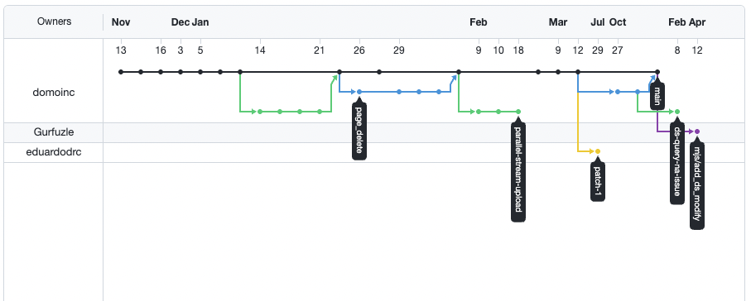
Example git repository
https://github.com/domoinc/rdomo/network

Slide 7
How to interact with Git/github
Command line
Always available, especially on Unix based system (Mac included)
Probably most difficult way to interact with Git
From your IDE
Your IDE will often provide sufficient functionality.
Merge functionality is often missing.
Have to worry about authenticating (can be painful e.g. R Studio)
GitHub Desktop
Makes things much easier.
My preferred method.

Slide 8
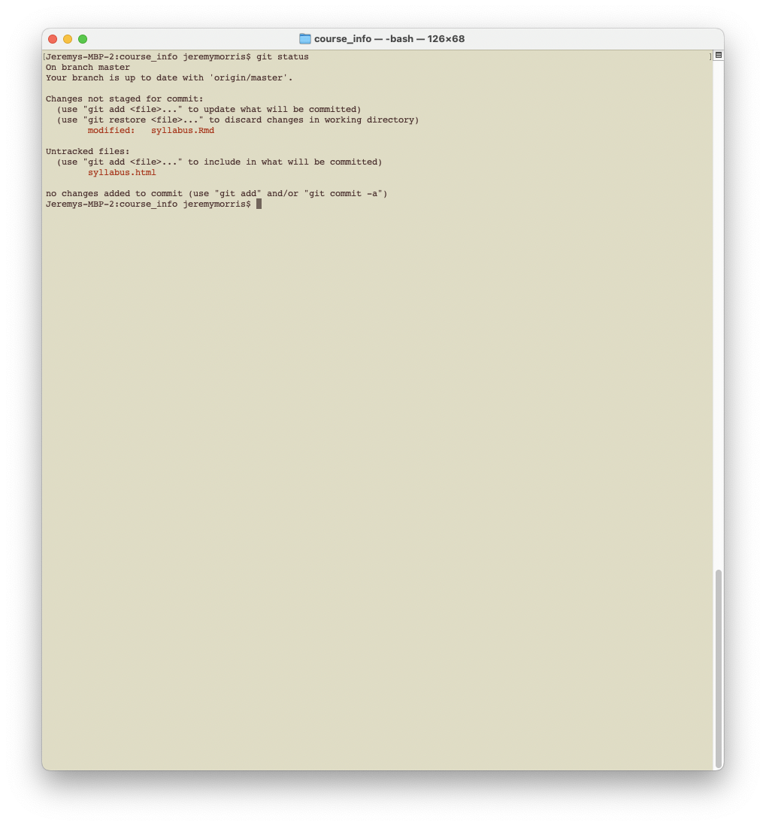
Command line

Slide 9
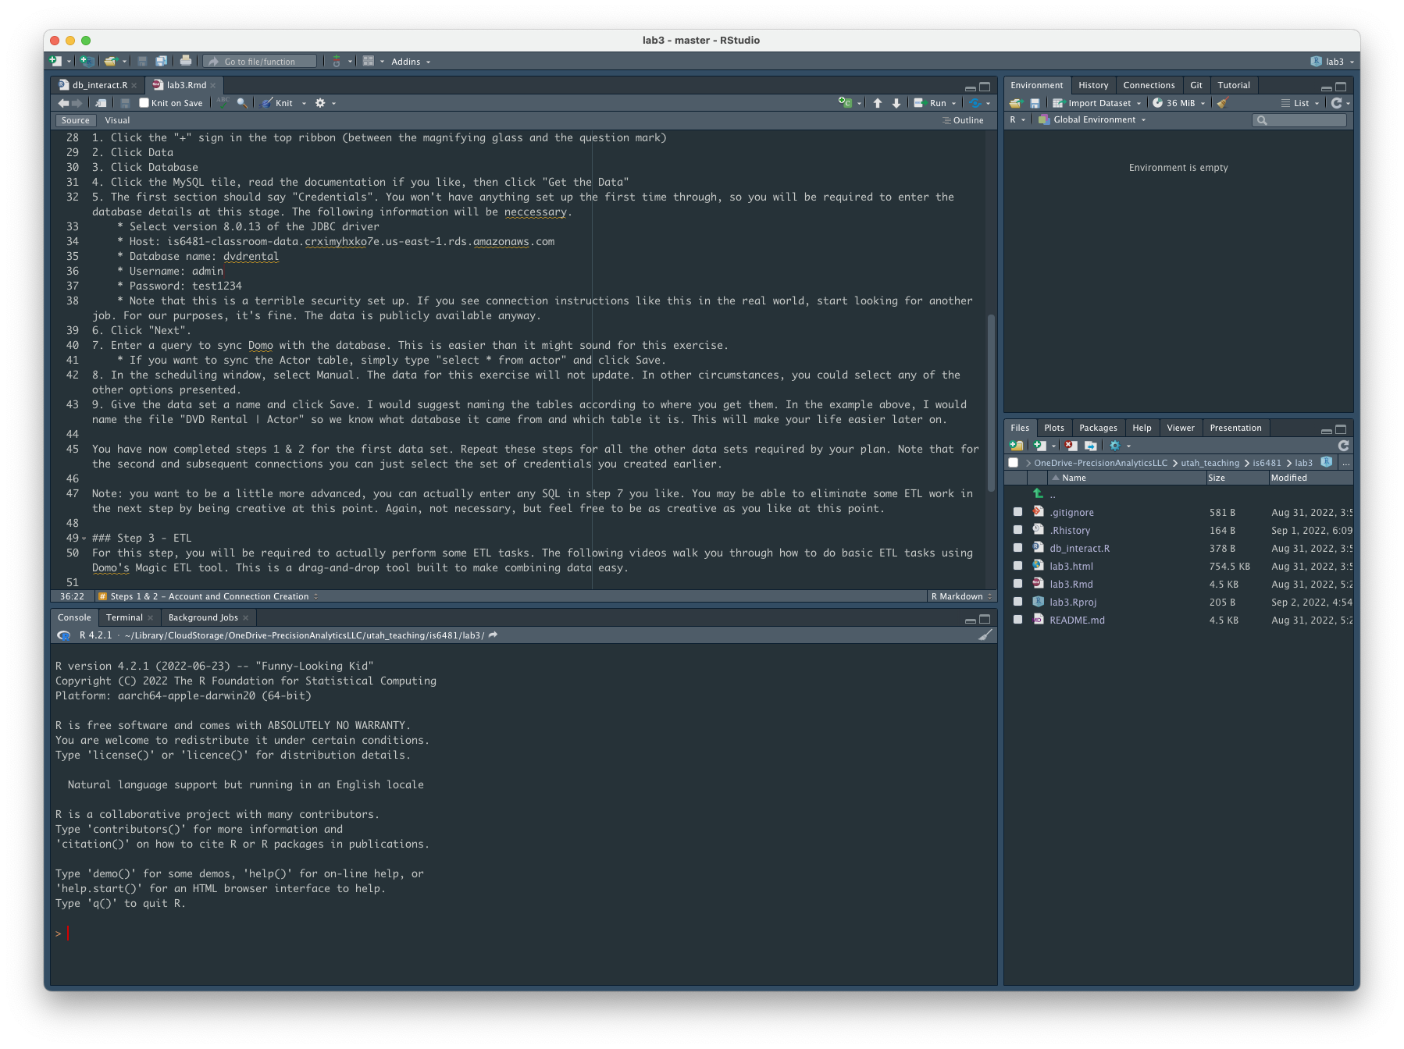
R studio

Slide 10
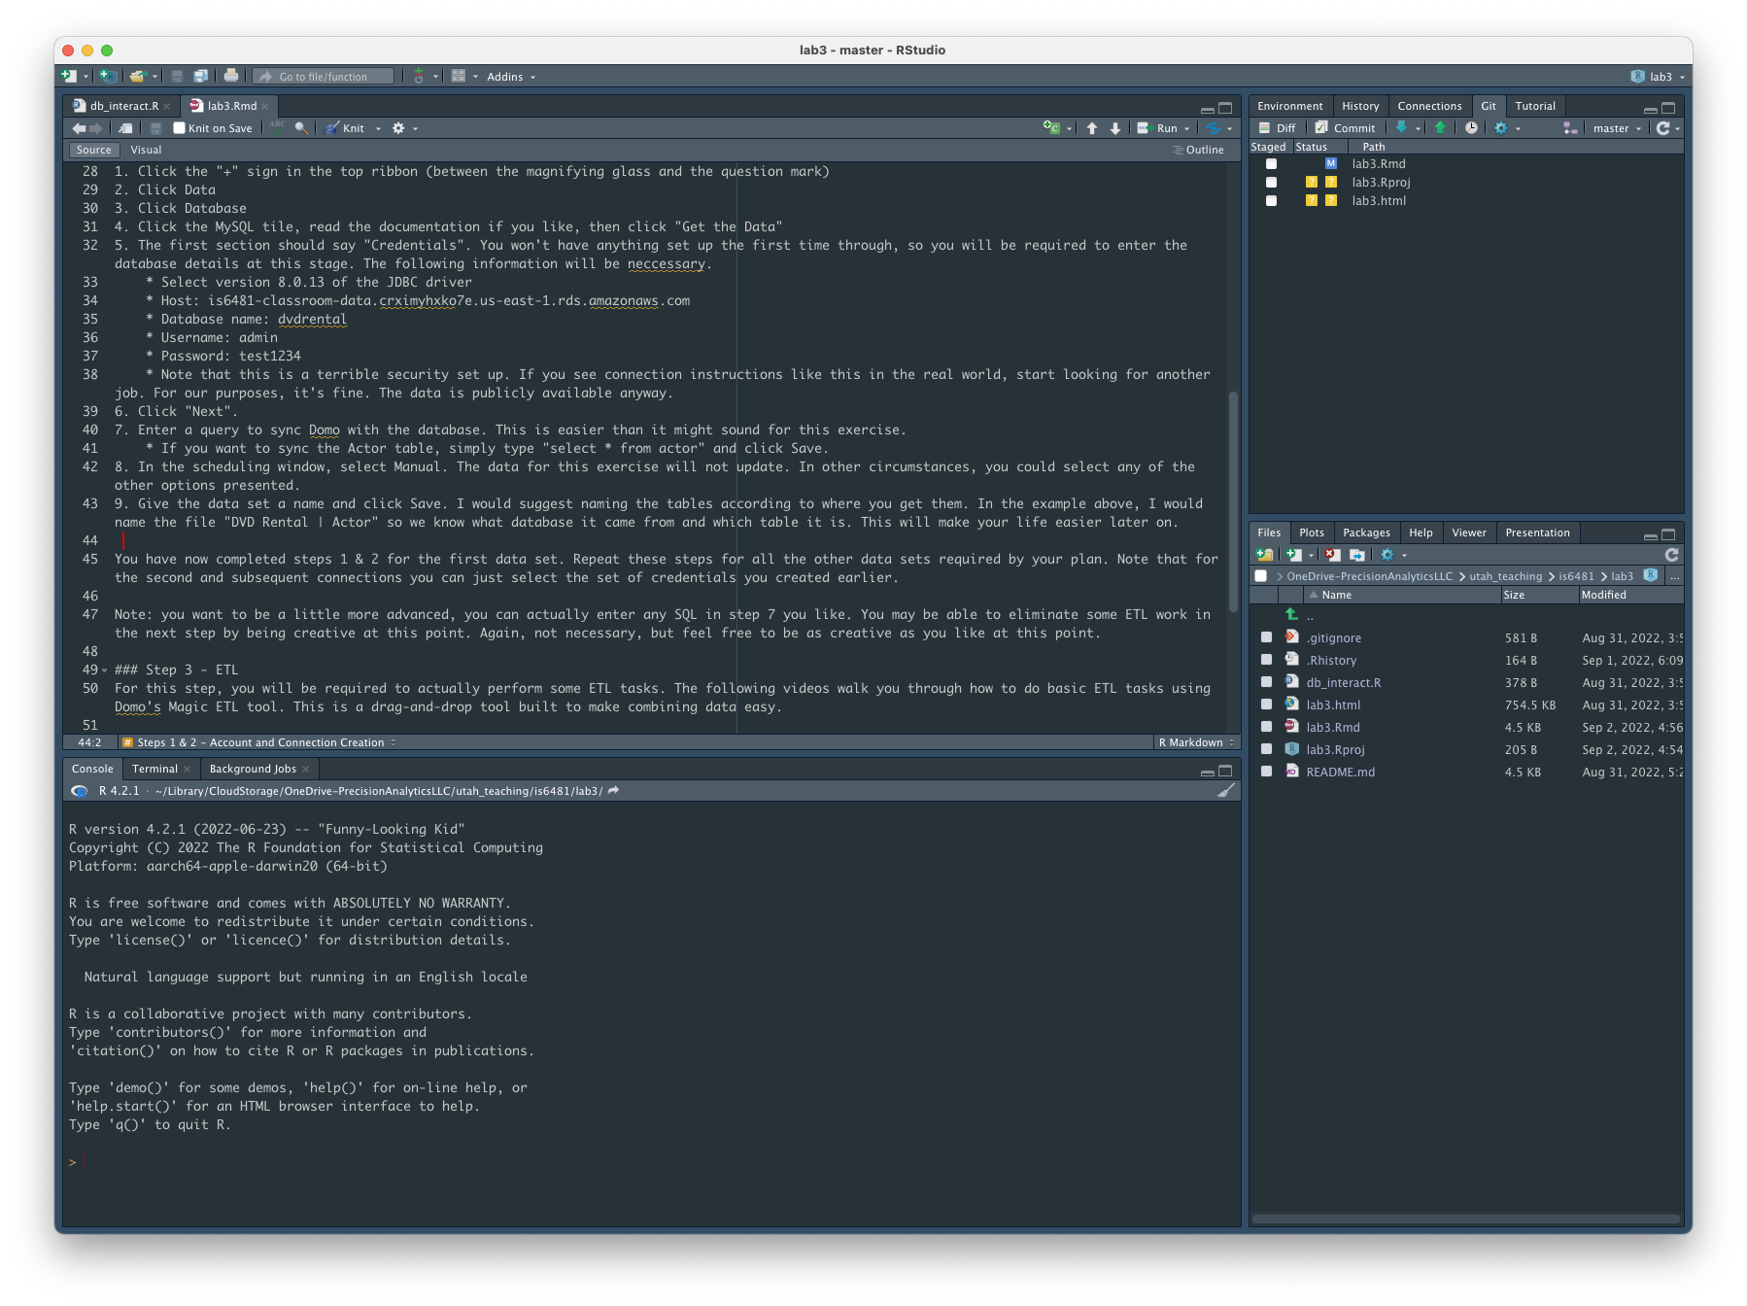

Slide 11
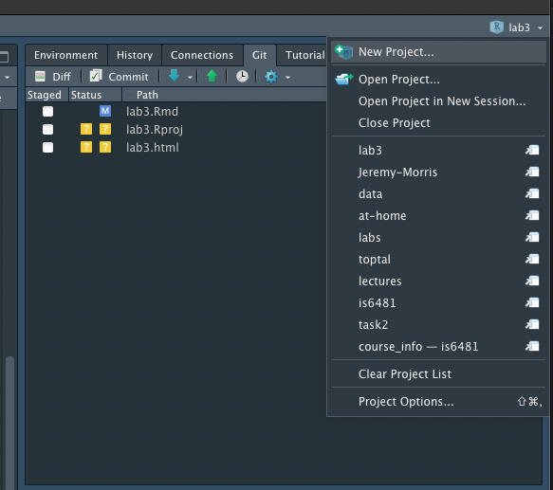
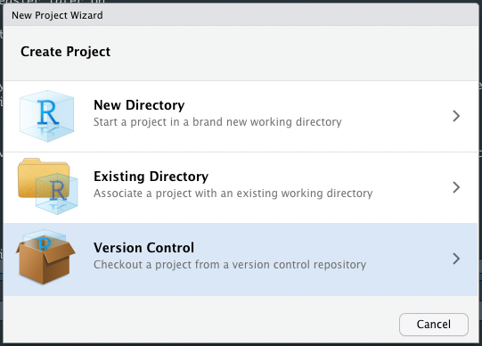
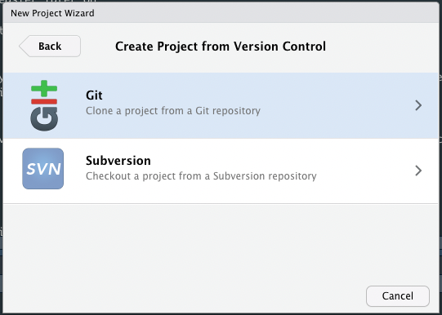
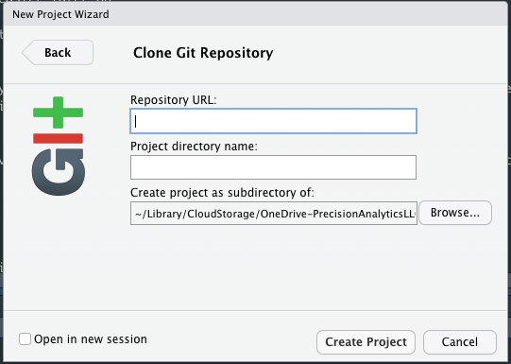
Rstudio | New Repository
Click the project in the top right
Click “New Project”
Version Control
Git
Enter information

Slide 12
Always use projects in rstudio
Why?
The project knows which folder its in and you never have to tell your script where you are.
You are already working in a folder.
Helps to keep things organized.
Easily connects to version control (Git/GitHub).
Easily switch between projects.
Rstudio will reset your session when you switch (avoids environment contamination).

Slide 13
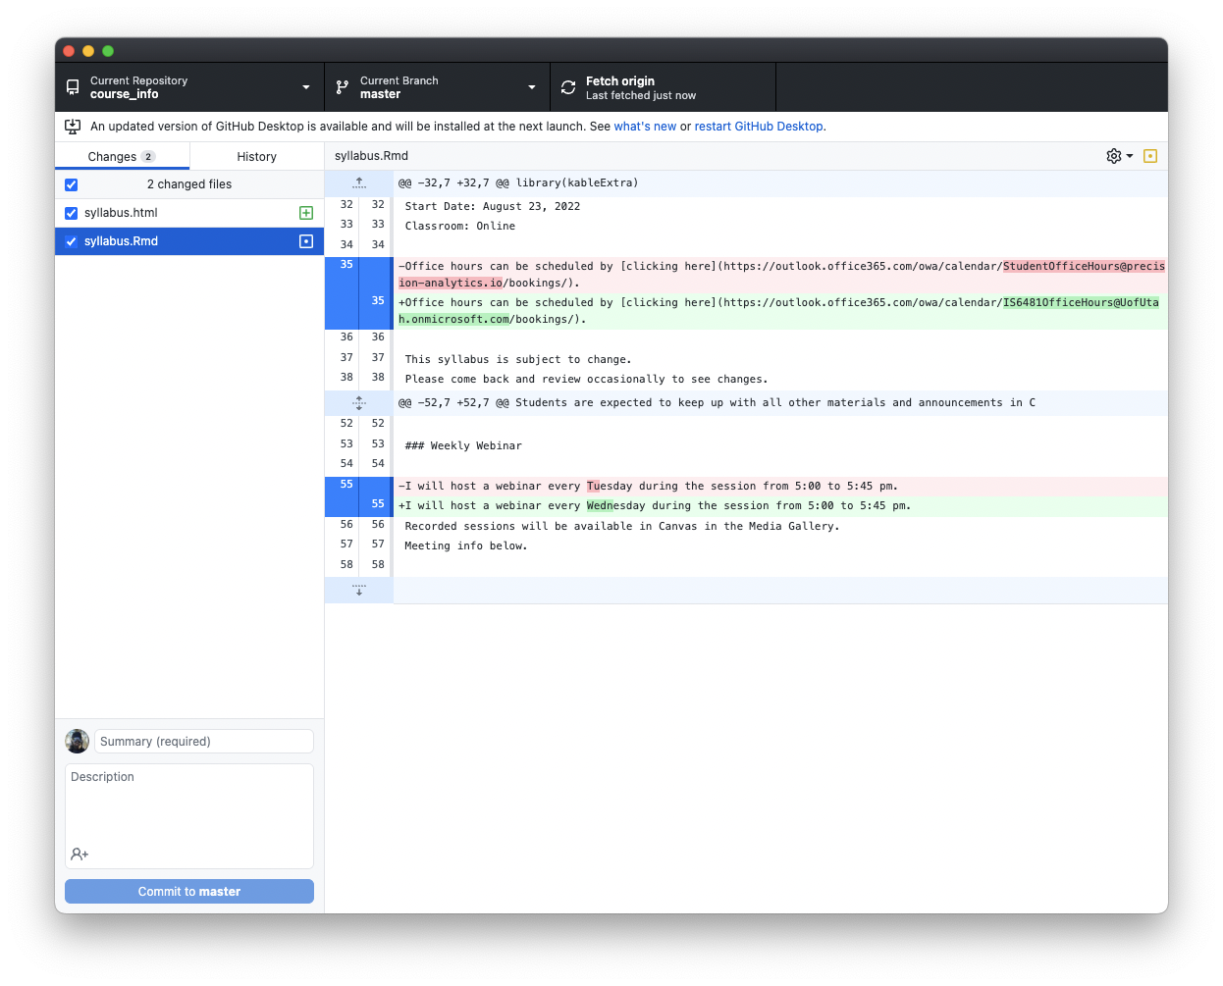

Slide 14
what do you commit
Go ahead:
Code
Presentations
Other text files
Think about it:
Data
HTML output from Rmarkdown
Ditto other kinds of output
Never, under any circumstances:
Usernames
Passwords
Authentication tokens
Other sensitive information (PII)
Git file size restrictions
In most cases, data will be acquired from a data store, you won’t need it in the repo
If someone could clone your repo and reproduce the results, you don’t need to commit them

Slide 15
Exit to demo

Slide 16
assignment
Using the Git program you are most comfortable do the following.
Option 1: Create a new Git repository from scratch
Option 2: Add a Git repository to an existing folder
Create an account at GitHub.com (if you haven’t already)
Once this is done, do the following.
Make edits to one or more files in the folder
Commit those changes
(Feel free to repeat as often as you like)
Push changes to your GitHub account
Browse to your repository on GitHub and do the following
Go to Insights
Go to Network
Copy the network diagram and paste into your final writeup
Turn in a Presentation that describes your experience using Git and GitHub, include the screen shot of your repository’s network diagram.

Slide 17
Help for rstudio
Click here for some help setting up Rstudio (note that I haven’t been able to get this to work yet).

Slide 18


